Slide 1
GY 30 Ryan White Kick Off
February 26, 2020

Slide 2
Washington DC EMA
The Washington, D.C. EMA consists of:
The District of Columbia
Northern and Northwestern Virginia (17 counties/cities)
Suburban Maryland (five counties)
West Virginia (two counties)

Slide 3
District of Columbia
46%
Maryland
33%
Distribution of Cases Living with HIV Disease
in the DC EMA, 2018,
by Jurisdiction N= 38,414
Virginia
20%
West Virginia 1%
Notes:
As of December 31, 2018, 38,414 persons were diagnosed and living with HIV in the Washington DC EMA. The overall prevalence of people living with HIV (PLWH) for the EMA at the end of 2018 (0.6%) is nearly twice the national estimated prevalence rate of 0.4% for diagnoses of HIV. The epicenter of the EMA is the District of Columbia, which is 11.7% of the EMA population, but 46.4% of all EMA HIV cases.

Slide 4
Geographic Distribution of the Number of Living in the DC EMA, by County, 2018, N=38,414
DC
Number of HIV Cases
1-311
312-1,927
1,928-5,595
5,596-8,667
8,668-17,830
Notes:
Figure X describes the geographic distribution of cases diagnosed in the DC EMA. Washington DC had the highest number of diagnosed cases (17,830) followed by Prince Georges County, MD (7,433), Montgomery County, MD (4,138) and Fairfax County, VA (2,724).

Slide 5
Special Population in the EMA
Of the 38,414 HIV cases living in the EMA, 24% were Black women, 17% among youth aged 13-24, 16% among foreign-born diagnosed with HIV and 10% among black heterosexual men.
Black Women
24%
Black Heterosexual Men 10%
Black MSM 18-24
4%
Black MSM 13-17
0.2%
Black MSM 25-29
4%
Hispanic
MSM
6%
Youth 13-24
17%
Living HIV Cases
Foreign-born
16%
Transgender
persons
1%
Hispanic
women
2%

Slide 6
DC EMA Ryan white clients
11,173 Clients
DC 6,707 60%
MD 1,953 17%
VA 2,361 21%
WV 152 1%

Slide 7
Dc EMA ryan white clients n=11,173

Slide 8
Dc EMA ryan white clients n=11,173

Slide 9
Dc EMA ryan white continuum of care

Slide 10
Dc EMA ryan white continuum of care by age

Slide 11
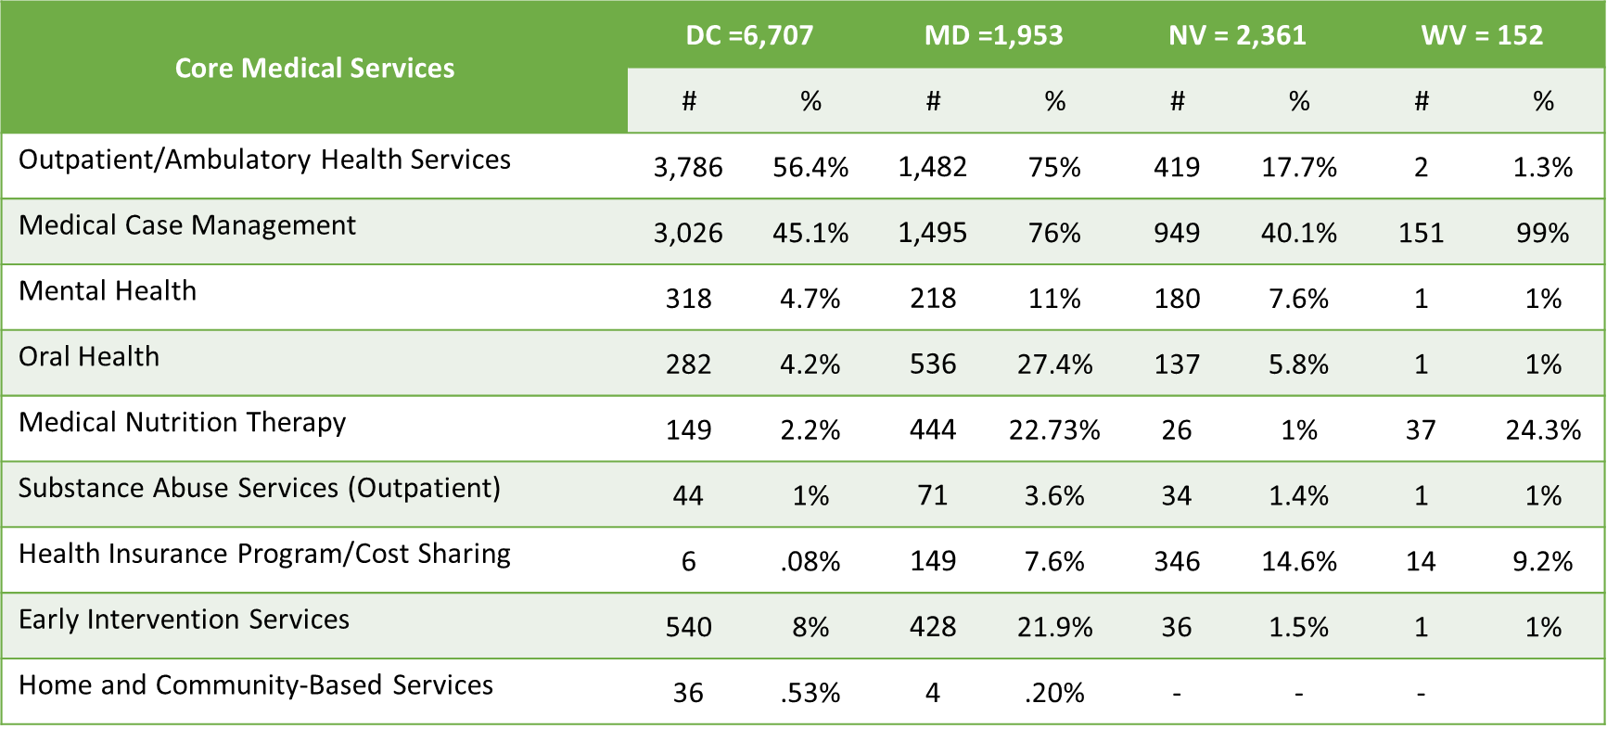
Clients by core service category

Slide 12
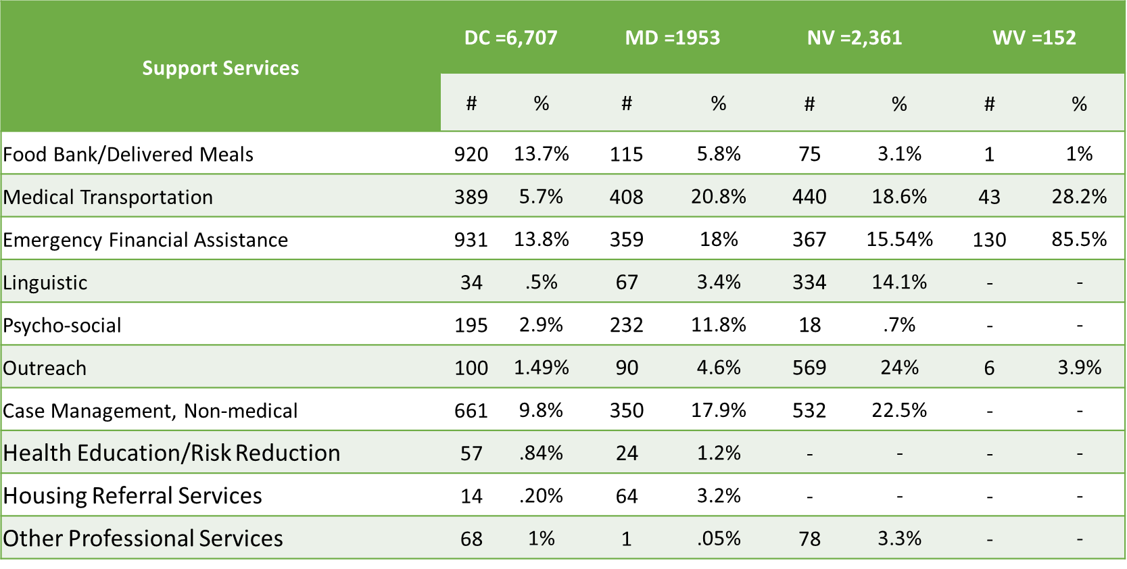
Clients by support service category

Slide 13
EMA TOP 10 most used service categories
Notes:
The updated plan will be structured using the same goals for now, but tasks and activities will align with new areas of focus. The focus areas HAHSTA have identified for the updated plan, and further conversations with community are:

Slide 14
Minority aids initiative (MAI) – youth reach
Targeted initiative geared towards serving youth of color ages 13-30
Goal: provide a seamless transition from prevention and testing programs into care
Six service categories comprising MAI-Youth Reach
Outpatient/ Ambulatory Health Services
Early Intervention
Medical Case Management
Substance Abuse Outpatient Care
Mental Health
Psychosocial Services

Slide 15
Minority aids initiative (MAI) – youth reach

Slide 16
Rate of hiv living in the district by census tract, 2018, n=12,322*
Rate of HIV per
100,000 persons
0-933.2
933.3-1,850.7
1,850.8-2,587.5
2,587.6-3,389.2
*5% of cases had a missing address or an address that did not geocode and were not included in this map. Though not included in this map, 51 cases were in jail and 79 cases were homeless
3,389.3-4,827.1

Slide 17
ADAp services
Rebranding as DC Pharmacy Benefits Program
Provides other drug assistance for PrEP, Rapid ART and Suboxone (not all paid through RW)
Types of Services
Insurance premium payments
Co-pay assistance
Straight prescription coverage

Slide 18
Ending the epidemic

Slide 19
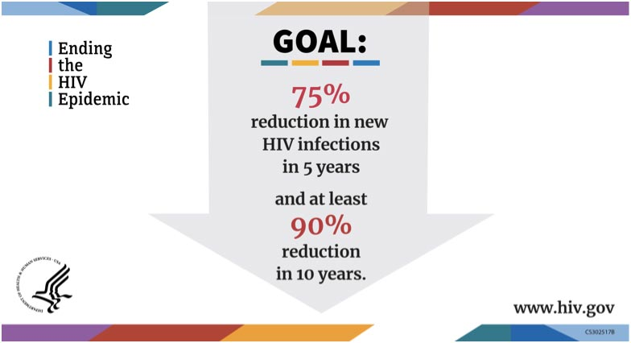
Ending the epidemic

Slide 20
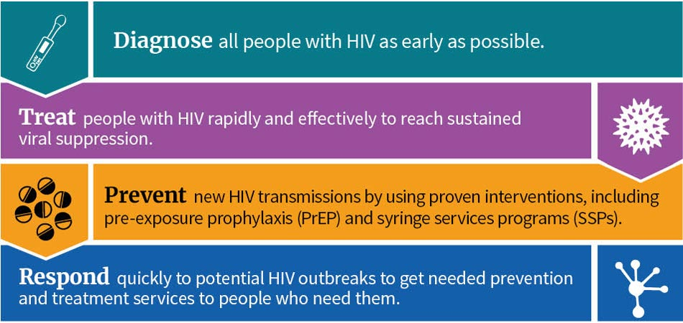
Ending the epidemic

Slide 21
Ending the epidemic
Phase 1 – Geographic Focus (5 years)
57 jurisdictions identified as geographic hotspots
DC, Prince Georges County and Montgomery County
Phase 2 – Nationwide efforts
Goal – reduce new infections by 90% by 2030
Phase 3 – Intensive Case Management
Goal - maintain the number of new infections at fewer than 3,000 per year
Notes:
The updated plan will be structured using the same goals for now, but tasks and activities will align with new areas of focus. The focus areas HAHSTA have identified for the updated plan, and further conversations with community are:

Slide 22
Ending the epidemic
Funding
CDC (Single jurisdiction)
PS 19-1906 – community engagement
PS 20-2010 – Implementation
HRSA (57 jurisdictions)
20-078 - Implementation

Slide 23
Subrecipient requirements
Monthly reports
Narrative
Data
Invoices
Due by the 10th business day of each month
Participation in surveys/data collection
Needs assessment, focus on out of care, newly engaged/re-engaged
AEAM
QM
We are required to consider past performance when making new awards

Slide 24
2019 HRSA Site visit
Strengths
QM coaching model
Staff knowledge and engagement
Findings
Customer (client) eligibility
Subrecipient monitoring
340B Program income, Adherence to service standards
UBC cost reconciliation
Notes:
The updated plan will be structured using the same goals for now, but tasks and activities will align with new areas of focus. The focus areas HAHSTA have identified for the updated plan, and further conversations with community are:

Slide 25
Updates for gy 30
Requests for increased funding/unusual purchase
Fully develop request and contact your PO
Special purchases are not allowed after Q3
Evaluation of the FFS/UBC Business Model
Provider survey
New RFA
Summer 2020 release
March 1, 2021 start date
Notes:
The updated plan will be structured using the same goals for now, but tasks and activities will align with new areas of focus. The focus areas HAHSTA have identified for the updated plan, and further conversations with community are:

Slide 26
Thank you.

