Slide 1
Unit-Based Cost/Human Care Agreements

Slide 2
Unit-Based Reimbursement/HCAs
Outpatient Ambulatory Health Services
Oral Health Services
Outpatient Substance Abuse/Mental Health
Food Bank & Home-Delivered Meals
Non-Medical Case Management/Housing Services

Slide 3
Human Care Agreements
GY30 Contract Modifications
Housing Services contract terminates on 2/29/2020
Non-Medical Case Management (nMCM) contract modified to include Housing Services
All providers funded for nMCM are eligible to bill for Housing Services
GY30 Housing Services is EMA-wide

Slide 4
nMCM Modification Cont’d
Not for General Use: Centralized Eligibility (Pilot)
Housing Services Plan
90-Day Re-Evaluation of Housing Plan
6 Month Housing Plan Revision
Annual Re-Evaluation of Housing Plan
Housing Encounter (facility based)
Home Visit
Housing Encounter F/U (30 mins) or (15 mins)
Housing Electronic Follow Up/Communication

Slide 5
nMCM Modification Cont’d
Exclusion: Organizations funded by HUD - HOPWA for facility-based Case Management Services may NOT seek reimbursement for duplicative services under this HCA
Customers may receive both nMCM and Housing Services
Documentation in customer record must support billing for service delivery

Slide 6
nMCM Modification Cont’d
Caps apply
max reimbursement 8 Encounters per service category, per client, per month
Max reimbursement for Housing Services is 8. Any combo of Housing Encounter & Home Visit

Slide 7
HCA Contracts & Purchase orders
Each HCA has a unique CW#
CW# does not change
NTE – Contract Spending Cap
Grant Year: March 1 – Feb 28
Purchase Orders
Two POs per Grant Year
March 1 – Sept 30
Oct 1 - Feb 28
POs can be increased as needed

Slide 8
E-Invoicing Process for RW HCAs
Complete Payment Request Package submitted in E-invoicing:
Completed, signed invoice
CAREWare Financial Report
Monthly Narrative Report
Supporting financial documents, if applicable
*NO PHI SUBMITTED IN E-INVOICING!
Service units on invoice must match CAREWare Financial Report
Sign Invoice & PDF entire package

Slide 9
Invoicing Process cont’d
Ryan White must be the payor of last resort!
SINGLE Submission Supplemental Invoice due NLT 3/31/20 (and 10/31/20)
Includes all services not previously billed during the Purchase Order dates
Supplemental Invoice Package consists of invoice, CAREWare Financial Report, monthly narrative template (summary of submission)

Slide 10
Invoicing Process cont’d
Templates for invoices will be distributed by email
Invoices are due 10th business day
The District shall pay on or by the 30th day after receiving a proper invoice
Invoices will NOT be accepted after 30 days past the end of grant period: March 31st deadline

Slide 11
Invoicing Process cont’d
Invoices are contract specific
Invoices must include:
Contract No.
Invoice Number
Billing Period
Provider Name and Address
Fed ID
Name, title, phone of responsible official and authorized signature and date of signature

Slide 12
Invoicing Process cont’d
Units
Enter units in column 1, expenditures will automatically calculate
Units must match CAREWare Financial Report
Unit is per client/per service except where otherwise specified

Slide 17
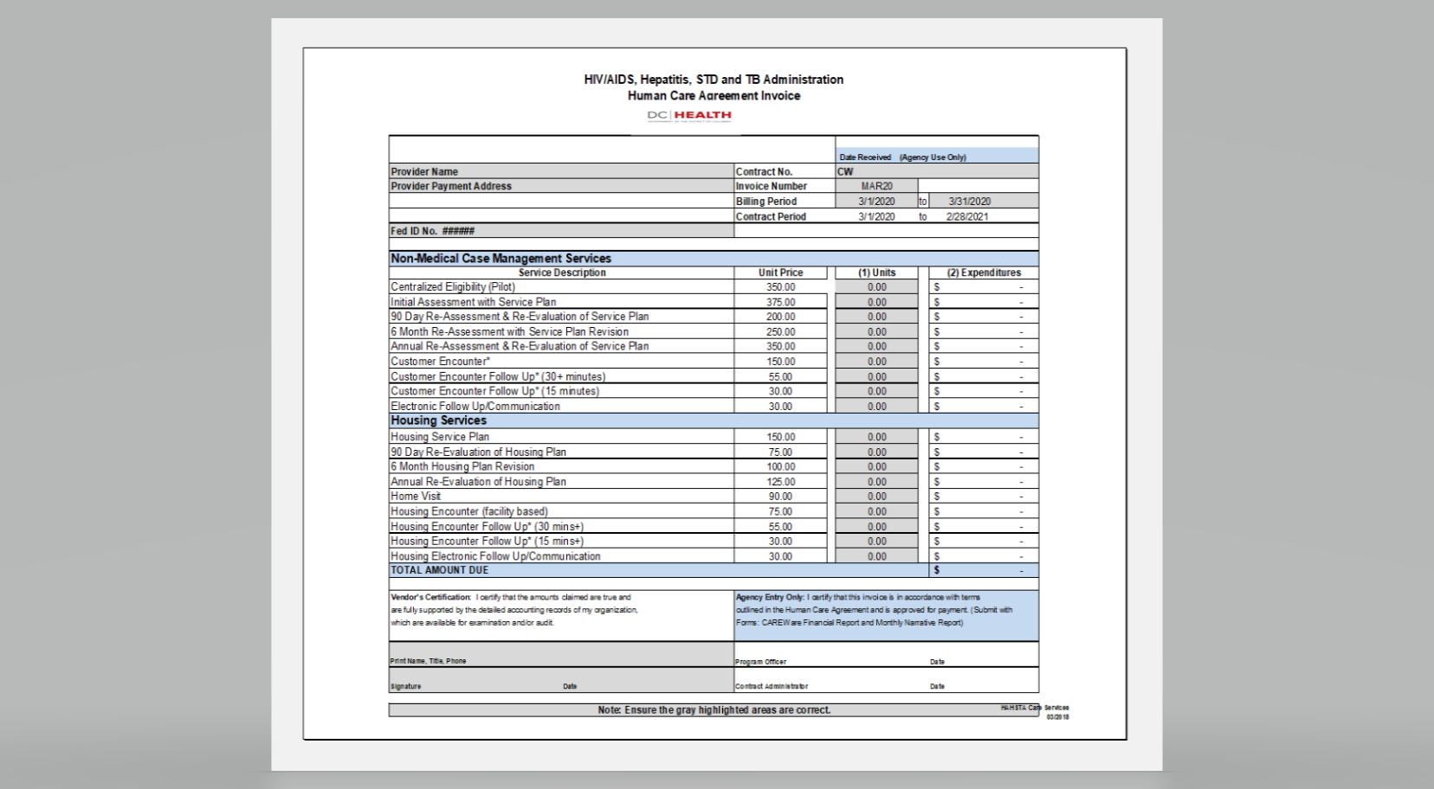

Slide 18
Reimbursement will be made on a monthly basis.
Invoices to be submitted no later than the 10th business day of the month for services rendered during the prior month.
Reimbursement will be based upon the fixed rates established in the Human Care Agreements.

Slide 19
All invoices will be submitted through the PASS E-Invoicing system. Follow instructions to “Create and Submit an Invoice” from the PASS DC Vendor Portal found in the Vendor Manual. Please see https://vendorportal.dc.gov/Tutorials for further assistance
Vendor Invoice Number should be labeled as the first three letters of month and two digit year the invoice is corresponding (i.e.MAR20, APR20, MAY20…SUPP20)

Slide 20
The following documents will be submitted under “Additional Attachments” and constitute a complete payment request package:
Completed and signed invoice
Supporting financial documents* (as appropriate)
CAREWare Financial Report
Monthly Narrative Report

Slide 21
*Supporting financial documents demonstrating proof of payment are required for all reimbursements made for Dental Appliances and Lab Tests & will be uploaded into ShareFile.
This supporting documentation will determine the amount of reimbursement made, as these services are contractually reimbursed “at cost.” Acceptable supporting documents include credit card receipts, bank statements, canceled checks, etc.

Slide 22
BLACK OUT ALL Protected Health Information before submitting attachments
Incomplete payment request packages will be rejected

Slide 23
Option Year Renewal & Close Out
Jewell Miles, DC Office of Contracts and Procurement, initiated the option year renewal process
New Grant Year begins March 1
Closing out GY29
Invoices for Oct19 through Feb20 will NOT be accepted after March 31, 2020 deadline

Slide 24
Thank You
Questions?

