Slide 1
DC EMA CAREWare
GY33 Plan
Messay Zerga(DOH)| Feb 2023

Slide 2
DC CAREWare website:
https://carewaredc.ixn.com/careware/rs/index.htm

Slide 3
What is New?
CAREWare upgraded to build v.171 which is RSR 2022 ready
Centralized Eligibility
Provider Data Import (PDIs) format change
Providers are encouraged to export their old data for backup
Please contact care.ware@dc.gov with specific inquiries

Slide 4
What is New?...
2 –Factor Authenticator resetting
Providers will be able to reset their users 2-factor key
If you are a site admins, please email at care.ware@dc.gov for further guidance
Automatic user Deactivation
Due to security concerns, users who didn’t login for 180 days(used to be 90 days) will automatically be retired/Deactivated
New Account reactivation request must be submitted to reinstate the account

Slide 5
Training
RSR 2022
January 31, 2023
Basic CW training for new users
Mid- April 2023
Working with Reports in CW
June 2023
Data Import and Export options
August 2023
Provider Specific training upon request
Through out the year

Slide 6
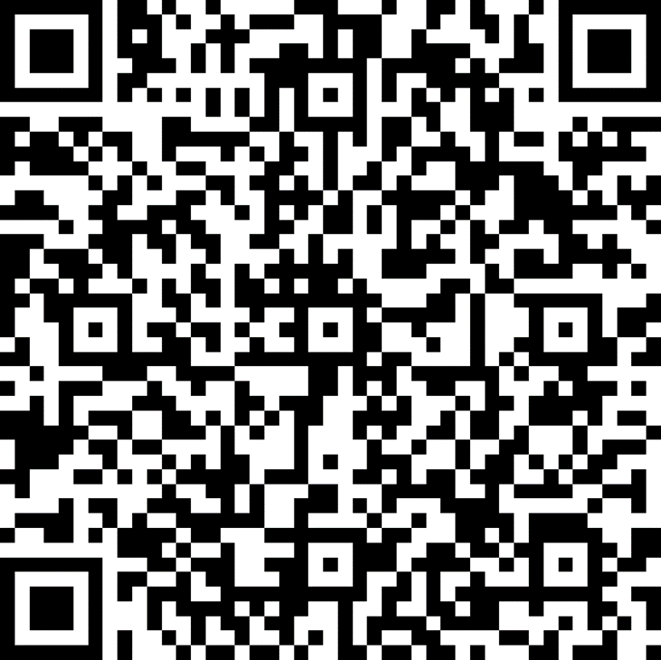
How to request User account
To access CAREWare User accounts Click here or scan QR code

Slide 7
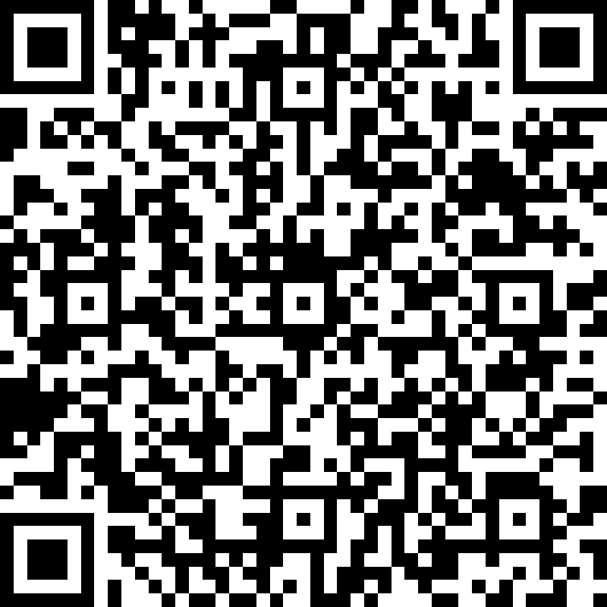
How to request TA
We have electronic TA request form
Click DC CAREWare TA request form
Or scan the barcode
All trainings will be hosted virtually via Microsoft team

Slide 8
Our goal this grant year
>97 % data completeness in all required data element areas
Viral Load
CD4
ART
FPL
Housing Status
Health coverage
Risk Factor & HIV status

Slide 9
Contact
Email: Care.ware@dc.gov
Phone: 202-671-4983/202-329-7294

